Slide 1
Data Models
A model is a representation of reality, ‘real world’ objects and events and their associations.
A model is a collection of tools for describing
  Data
  Data relationships
  Data semantics(how a data object represents a concept or object in the real word.)
  Data constraints
Various models falls into three different categories:
  Object-based data models
  Record Based Data Models
  Physical Data Models

Slide 2
Object Based Data Models
Use the concept of entities, attributes and relationships.
Used to describe data at the logical and view level.
It provides flexible structuring capabilities.
The most widely known ones are:
  The Entity-Relationship Model
  The Object-Oriented Model.

Slide 3
Entity-Relationship Model
It consists of basic objects called “Entities”, and “Relationships” among these objects.
An entity is a thing or object in the real world that is distinguishable from other objects.
Entities are described by set of attributes.
Entities are the principal data object about
which info is to be collected.
A relationship is association among
several entities.

Slide 4
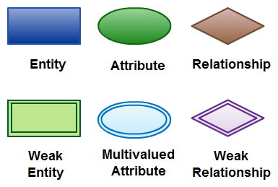
Entity-Relationship Model
Basic constructs of ER Model
  Entities
  Entity set (Set of entities of same type that share the same properties)
  Relationships
  Attributes (Describe the properties of entity)
    Simple Attribute
    Compound/Composite Attribute
    Derived Attribute
    Multivalued Attribute
  Degree of relationship
    No. of entities associated with the relationship (n-ary)
  Cardinality (Mapping)

Slide 5
Entity-Relationship Model (Cardinality)
One to one cardinality (One student has one Address/Contact No.)
One to many cardinality (One student registered in many courses)
(A department has many employees)
Many to one cardinality (Many employees are working in one dept.)
Many to Many (Employees can be assigned to more than two projects at a time)

Slide 6
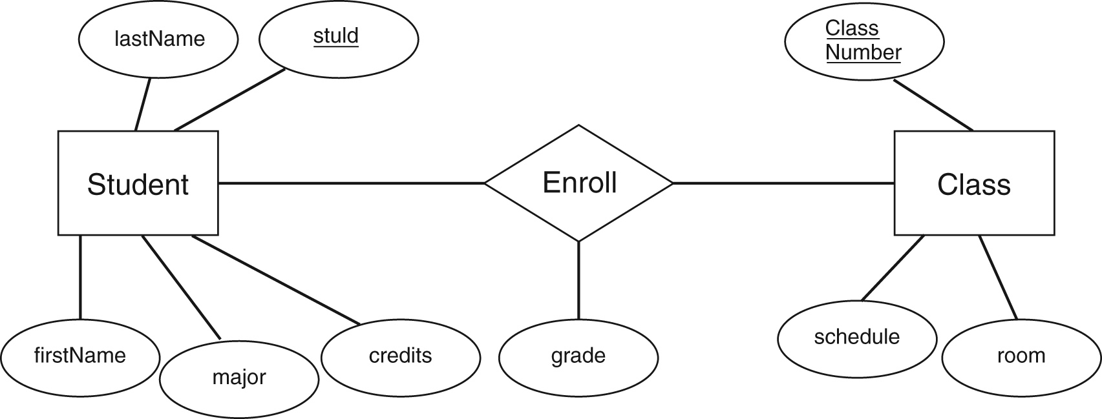
Entity-Relationship Model

Slide 7
Advantages
It makes the requirement simple and easily understandable by representing simple diagrams.
One can covert ER diagrams into record based data model easily.
Easy to understand ER diagrams
Disadvantages
No standard notations are available for ER diagram. There is great flexibility in the notation. It’s all depends upon the designer, how he draws it.
It is meant for high level designs. We cannot simplify for low level design like coding.

Slide 8
Object Oriented Data Model
Objects that contains the same types of values and the same methods are grouped together into classes.
Like ER model OODM is based on collection of objects.
Object contains both data and their relationship(with other objects).
Oops features like inheritance, encapsulation.
Eg. Person class(name,add,phone) inherited in employee class(empid,emptype,dept id)
Eg. A database having having employees engg manager accountant clerk belongs to a group persons(name,age,address)

Slide 9
Advantages
Because of its inheritance property, we can re-use the attributes and functionalities. It reduces the cost of maintaining the same data multiple times. Also, these informations are encapsulated and, there is no fear being misused by other objects. If we need any new feature we can easily add new class inherited from parent class and adds new features. Hence it reduces the overhead and maintenance costs.
Because of the above feature, it becomes more flexible in the case of any changes.
Codes are re-used because of inheritance.
Since each class binds its attributes and its functionality, it is same as representing the real world object. We can see each object as a real entity. Hence it is more understandable.
Disadvantages
It is not widely developed and complete to use it in the database systems. Hence it is not accepted by the users.
It is an approach for solving the requirement. It is not a technology. Hence it fails to put it in the database management systems.

Slide 10
Record Based Data Models
It is used to describe data at the logical and view level.
Record based models are so named because the database is structured in fixed format records of several types.
  Relational Model
  Network Model
  Hierarchal Model

Slide 11
Relational Model
Relational data model is the primary data model, which is used widely around the world for data storage and processing.
It stores data in the form of tables.
This concept was proposed by E.F. Codd, a researcher of IBM in year 1960s.
It uses a collection of tables to represent both data and relationship among the data.
Each table has multiple columns and each column has unique name.

Slide 12
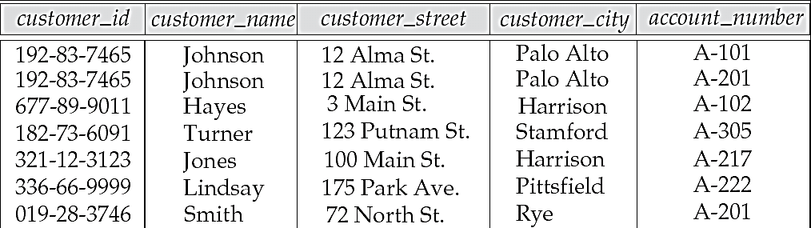
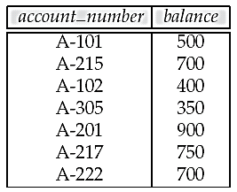
Relational Model

Slide 13
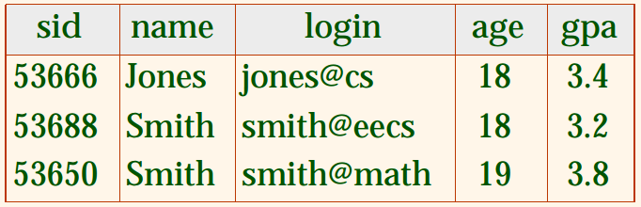
Basic Terminology used in Relational Model
Tuple of a relation (Each row is called aa tuple)
Cardinality of a relation (No. of tuples in a relation)
Degree of a relation (No. of attributes in a relation)
Domain (Set of all possible values that an attribute my validly contain)

Slide 14
Hierarchical database model
Organizes data in a tree structure (parent and child data).
Each entity has only one parent but can have several children.
At the top of the hierarchy, there is one entity, which is called the root.
1:N mapping between record types.
Eg. Department(no,name)→course(no,name,unit),student(id,name,courses)

Slide 15
Hierarchical database model
Advantages:
  Simplicity (Conceptually Simple)
  Data security
  Data Integrity
  Efficiency (Speed of access is faster because of the predefined data paths)
Disadvantages:
  implement complexity (The database designers should have very good knowledge of physical data storage.)
  database management problem(Any change in database structure then u need to make the necessary changes in all the application programs that access the database.)
  programming complexity (end user must know precisely how the data is distributed physically in the database in order to access data.)
  implementation limitation (only 1:n possible not m:n )
Notes:
Advantages:
Simplicity: Relationship between the various layers is logically simple. Thus design of a database is simple.
Data Integrity: Based on Parent/Child relationship. The child segments are always automatically referred by its parent, so this model promotes integrity.
Disadvantages:
Implementation Complexity: Although the hierarchal database model is conceptually simple and easy to design, it is quite complex to implement. The database designers should have very good knowledge of physical data storage.
Database management problem: Any change in database structure then u need to make the necessary changes in all the application programs that access the database.
Programming complexity: Due to the structural dependence, the end user must know precisely how the data is distributed physically in the database in order to access data.
Implementation Limitation: Many to many relationships are more common in real life but difficult to implement in a hierarchal model.

Slide 16
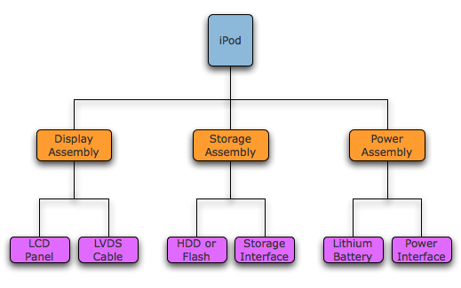
Hierarchical Database Model

Slide 17
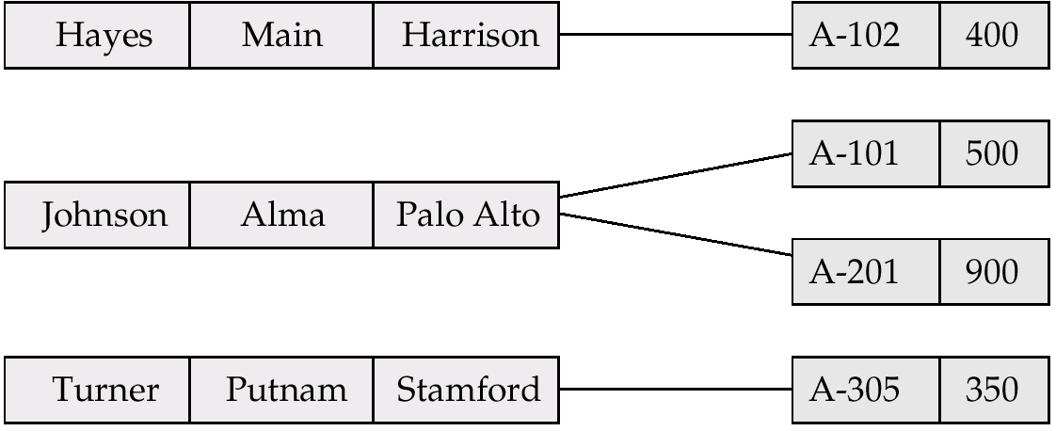
Network database model
In the network model, the entities are organized in a graph, in which some entities can be accessed through several paths.
Some data modeled with more than one parent per child.
Permits modeling of many-to-many relationships in data.
It is represented by collection of records and relationship among data is represented by links..

Slide 18
Network database model
Advantages:
  Easy to access data
  Can handle more relationship types
  Conceptually simple
  Data Integrity
Disadvantages
  System complexity (Pointers)
  Operational Anomalies (Change in any record require large number of pointers adjustments)
  Absence of structural independence. (if changes are made to db structure then all the application programs need to be modified before they can access the data)

Slide 19
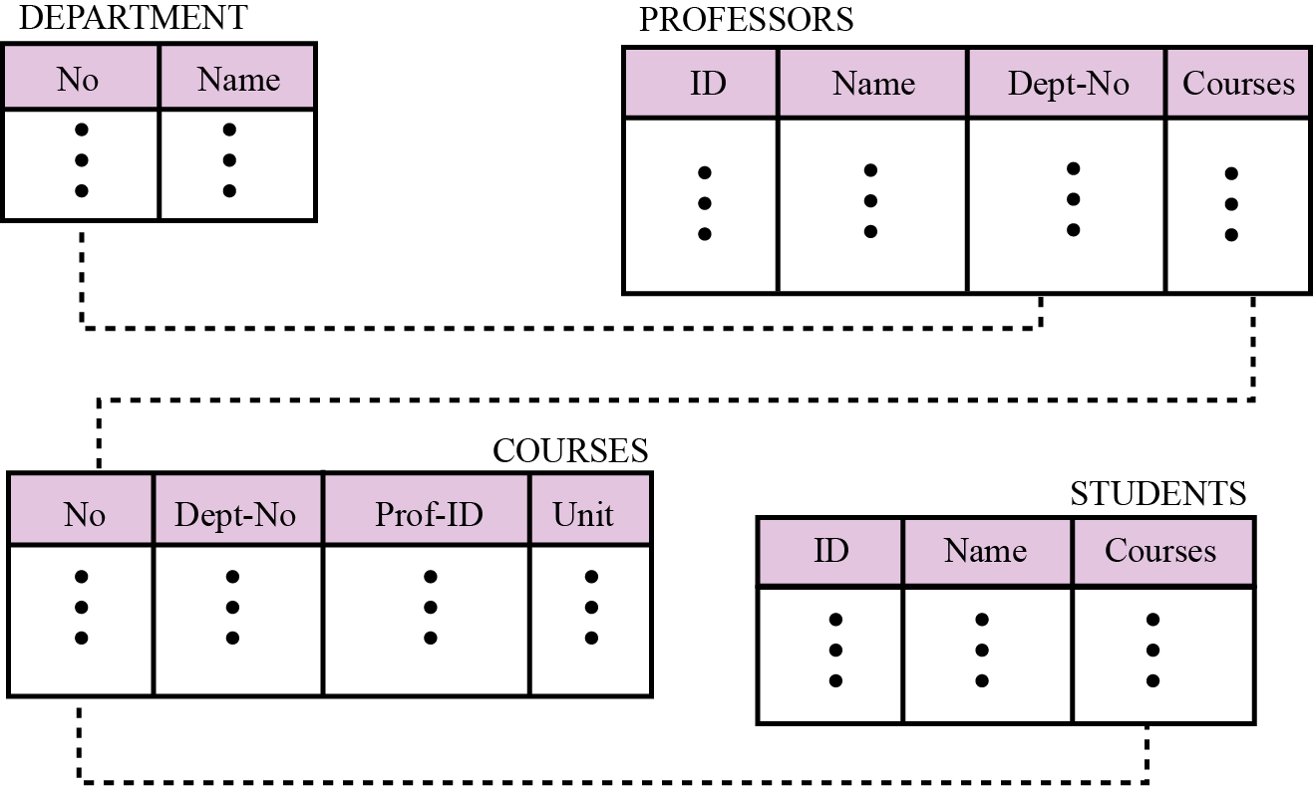
Relational database model
In the relational model, data is organized in two-dimensional tables called relations.

Slide 20
Database Constraint

Slide 21
Introduction
Constraints are the rules enforced on data columns on table. These are used to limit the type of data that can go into a table. This ensures the accuracy and reliability of the data in the database.
Constraints could be column level or table level.
Column level constraints are applied only to one column, whereas table level constraints are applied to the whole table.

Slide 22
Types of Constraints
Following are commonly used constraints available in SQL:
  NOT NULL Constraint: Ensures that a column cannot have NULL value.
  DEFAULT Constraint: Provides a default value for a column when none is specified.
  UNIQUE Constraint: Ensures that all values in a column are different. It can be a NULLL.
  PRIMARY Key: Uniquely identified each rows/records in a database table.
  FOREIGN Key: Uniquely identified a rows/records in any another database table.
  CHECK Constraint: The CHECK constraint ensures that all values in a column satisfy certain conditions.

Slide 23
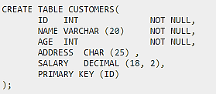
NULL Value Constraint
By default, a column can hold NULL values. If you do not want a column to have a NULL value, then you need to define such constraint on this column specifying that NULL is now not allowed for that column.
A NULL is not the same as no data, rather, it represents unknown data.

Slide 24
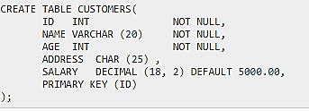
DEFAULT constraint
The DEFAULT constraint provides a default value to a column when the INSERT INTO statement does not provide a specific value.

Slide 25
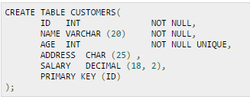
UNIQUE constraint
The UNIQUE Constraint prevents two records from having identical values in a particular column. In the CUSTOMERS table, for example, you might want to prevent two or more people from having identical age.
If CUSTOMERS table has already been created, then to add a UNIQUE constraint to AGE column, you would write a statement similar to the following:
ALTER TABLE CUSTOMERS MODIFY AGE INT NOT NULL UNIQUE;

Slide 26
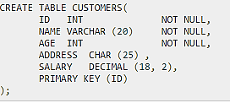
PRIMARY Constraints
A primary key is a field in a table which uniquely identifies each row/record in a database table. Primary keys must contain unique values. A primary key column cannot have NULL values.
A table can have only one primary key, which may consist of single or multiple fields. When multiple fields are used as a primary key, they are called a composite key.
If a table has a primary key defined on any field(s), then you can not have two records having the same value of that field(s).

Slide 27
Foreign Key Constraint
A foreign key is a key used to link two tables together. This is sometimes called a referencing key.
Foreign Key is a column or a combination of columns whose values match a Primary Key in a different table.
The relationship between 2 tables matches the Primary Key in one of the tables with a Foreign Key in the second table.

Slide 28
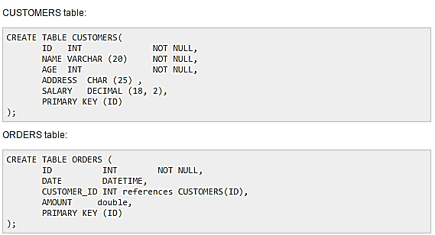
Foreign Key Constraint

Slide 29
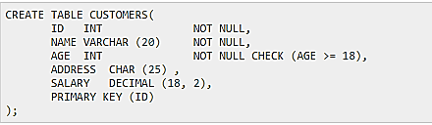
CHECK Constraint
The CHECK Constraint enables a condition to check the value being entered into a record. If the condition evaluates to false, the record violates the constraint and isn't entered into the table.

